Slide 1

Fire4s Prototype

Slide 2
Group Members
Neo Mokoana
Seeipati Sithole
Thokozani Maleka
Oko Mwezo

Slide 3
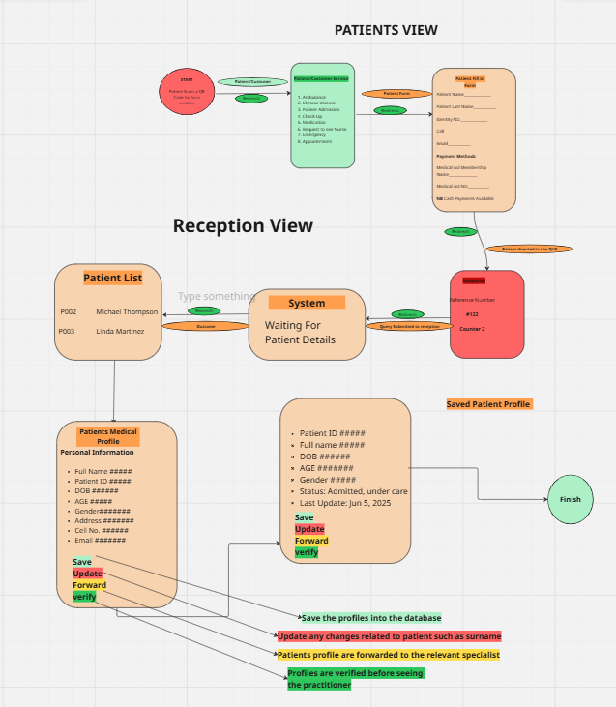
Diagram Flow

Slide 4
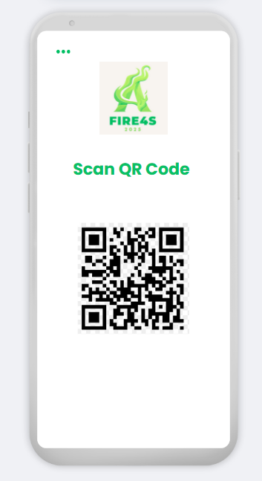
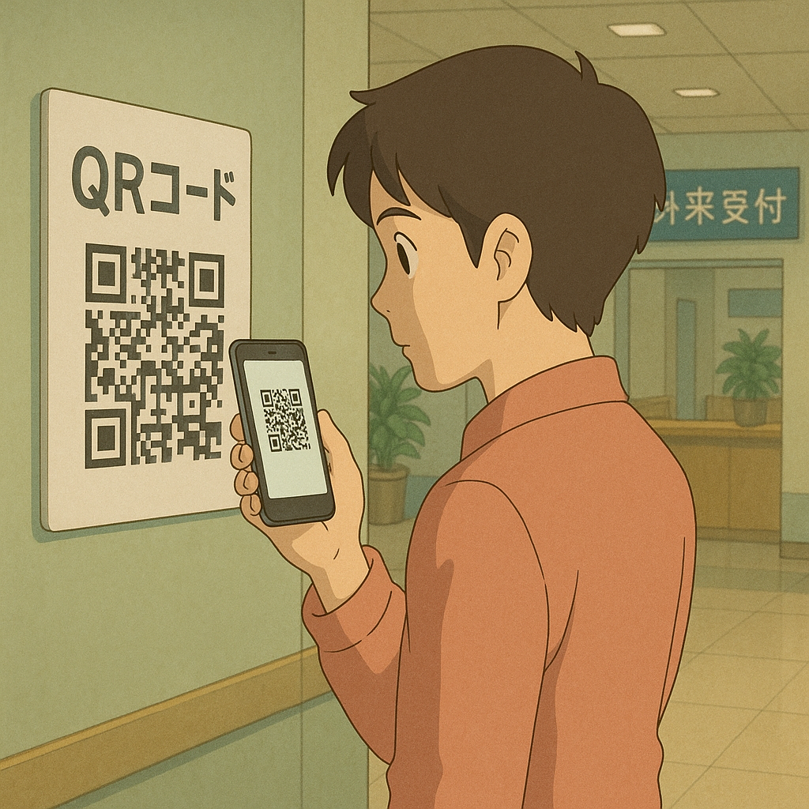
Open Page
Patient arrives at the hospital, then scans a QR Code on screen of the hospital.

Slide 5
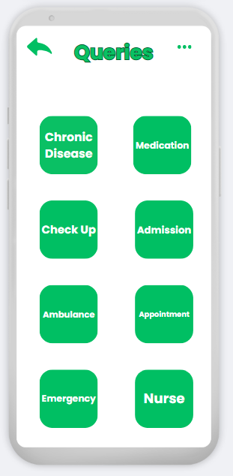
2nd Page
After scanning the QR code, on the 2nd page there will be options of queries that the patient will choose from, then will pick what query they have come about.

Slide 6
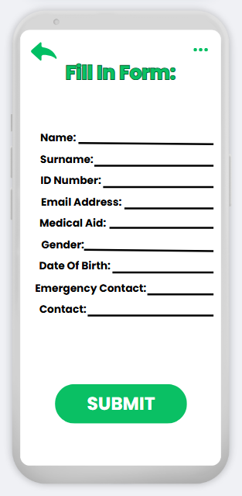
3rd Page
When you pick a query, it will take you to a fill in form whereby you enter the required details then it refers you to the correct receptionist that will direct you to the correct doctor of your query.

Slide 7
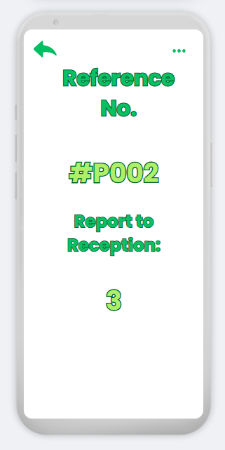
4th Page
On the 4th Page, the patient will receive a reference number and which reception table they should report to.

Slide 8
We will be looking the Receptionist's Point of View

Slide 9
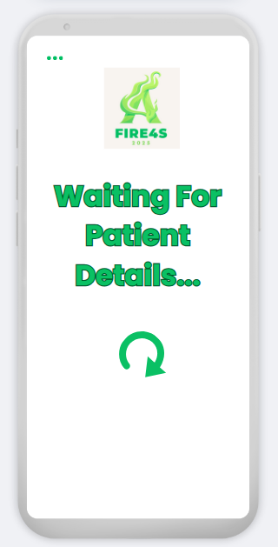

5th Page
On the receptionist's point of view, the receptionist will be waiting for the patient's details to appear on their end so they can know what to do.

Slide 10
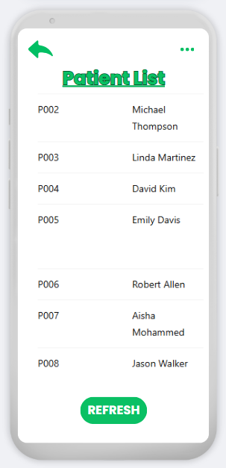
6th Page
Once the Patients have filled in the form from their end, they will click the submit button at the bottom, the receptionist will receive it on their end as a patient list whereby they have gone through every patient details and see if everything is in order then when the important details are in order then they will send the Patient to the relevant doctor.

Slide 11
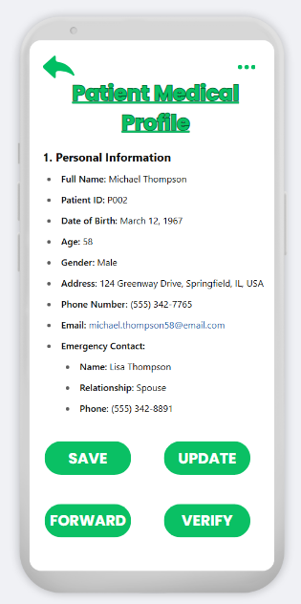
7th Page
The receptionist will click on one of the patients to see their details(example: Michael Thompson), the patient details will appear in a profile format. There will be buttons of 'save', 'update', 'forward' and 'verify'.

Slide 12
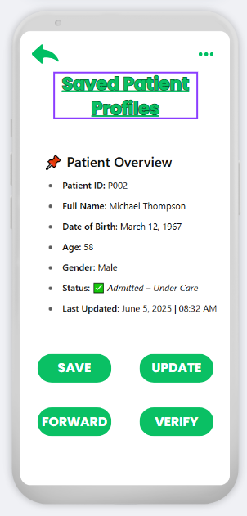
8th Page
This page shows the saved profiles that have been automatically saved into the database of the hospital.

Slide 13
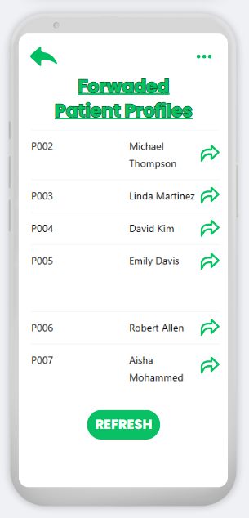
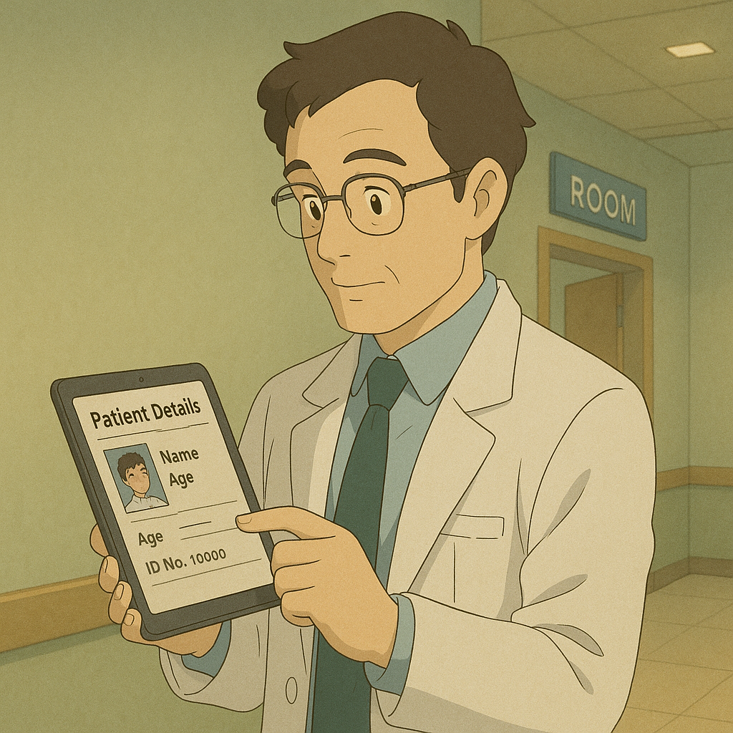
10th Page
This page is for the profiles that have been forwarded from the receptionist to the relevant doctor.

Slide 14
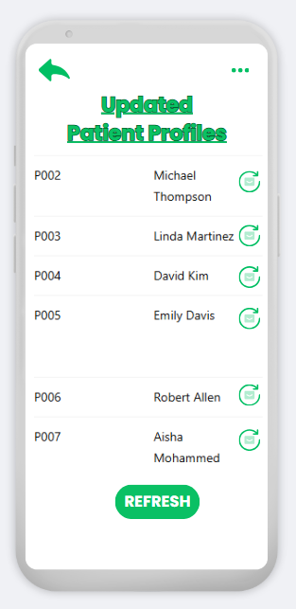
11th Page
This page is for the patient's details have been updated, for example if the patient has anew cell phone number or has new medical AID.

Slide 15
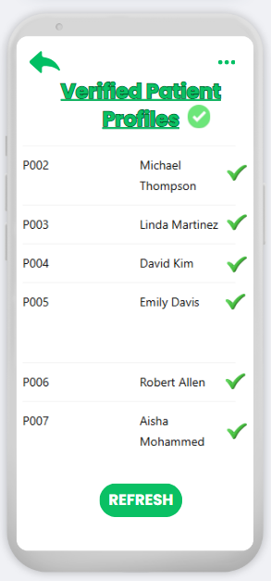
10th Page
This page is for verified profiles of patients who have been consistently coming

Slide 16
Flow Diagram

Slide 17
Thank you
https://www.canva.com/design/DAGpfID25XY/-A30Ri19PVgHTRuCc31Jtw/edit?utm_content=DAGpfID25XY&utm_campaign=designshare&utm_medium=link2&utm_source=sharebutton
https://www.figma.com/proto/kDgthDdE2Q19fTi0OuHFEb/Health-Final-Draft--?node-id=0-1&t=Cw2WzNTv3k5Zo9Pz-1
From Fire4s

